Slide 1
DriverPass System Design
Jailyn Mays
CS 255

Slide 2
System Requirements
Create accounts
Schedule lessons
Practice tests
24/7 access
Secure system

Slide 3
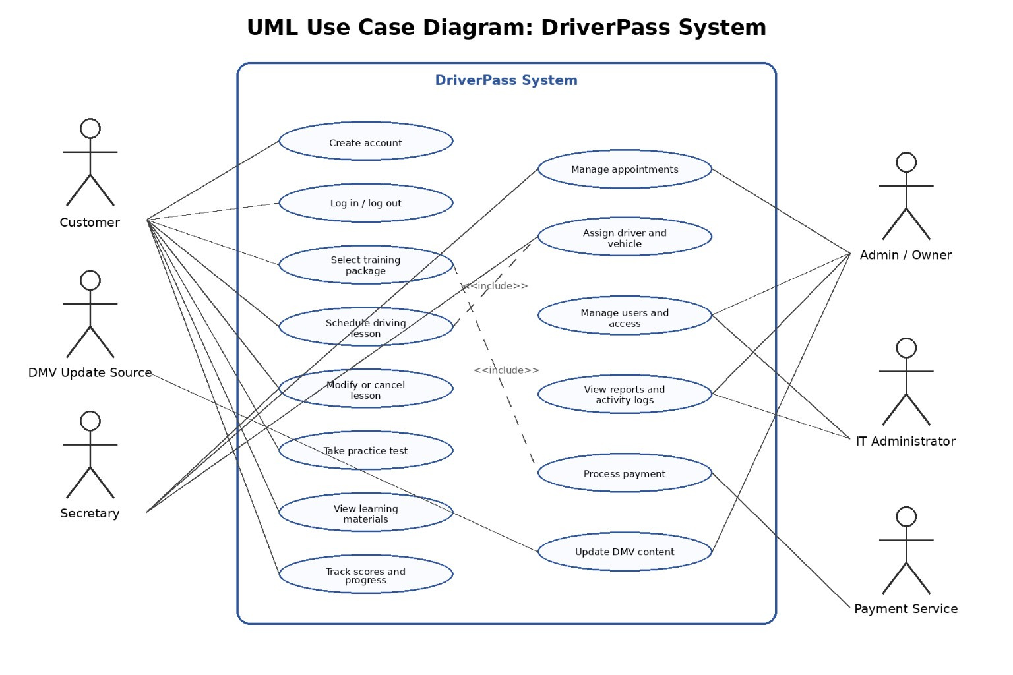
Use Case Diagram

Slide 4
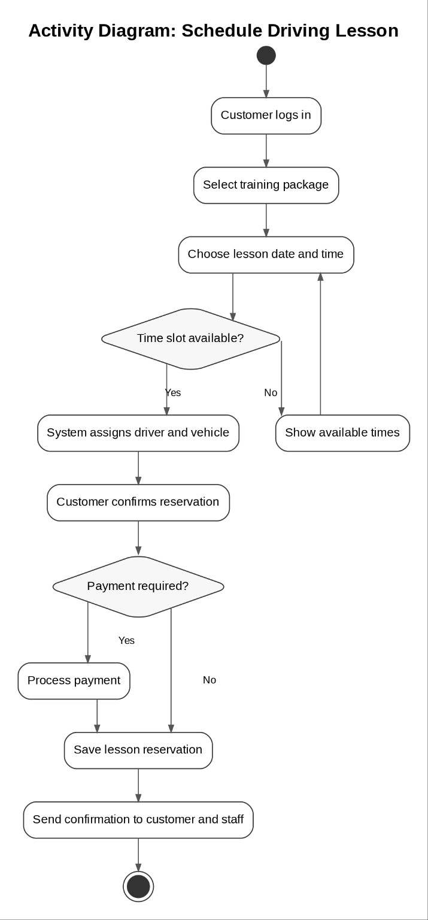
Activity Diagram

Slide 5
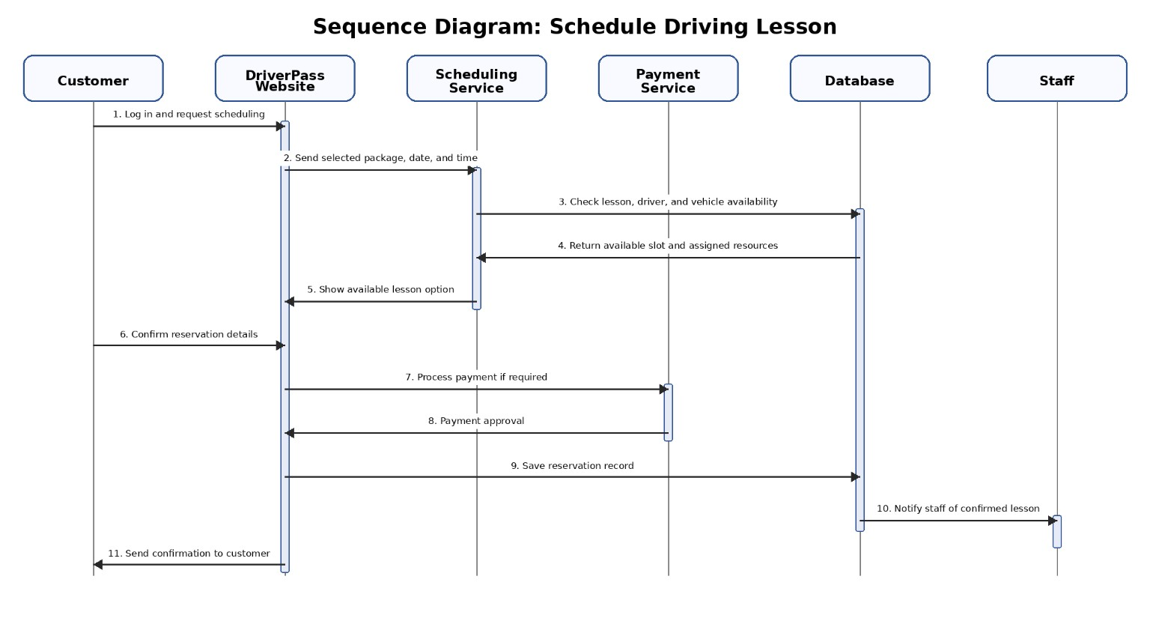
Sequence Diagram

Slide 6
Security
Encrypted data
Secure login
Account protection
Admin controls

Slide 7
System Limitations
Requires internet
Server dependent
Limited customization

